Slide 1
Course: Cloud, Microservices and Application (Elective I )
UNIT I: INTRODUCTION
SESSION 2
Cloud deployment models
Date: 16/7/2021

Slide 2
OUTLINE
4 cloud deployment models
-Public cloud
-Private cloud
-Community Cloud
-Hybrid Cloud

Slide 3
What is Deployment model
Deployment models describe the ways with which the cloud services can be deployed or made available to its customers, depending on the organizational structure and the provisioning location.
Four deployment models are usually distinguished, namely, public, private, community, and hybrid cloud service usage

Slide 4
Public Model
The cloud infrastructure is provisioned for open use by the general public.
It may be owned, managed, and operated by a business, academic, or government organization, or some combination of them.
It exists on the premises of the cloud provider

Slide 5
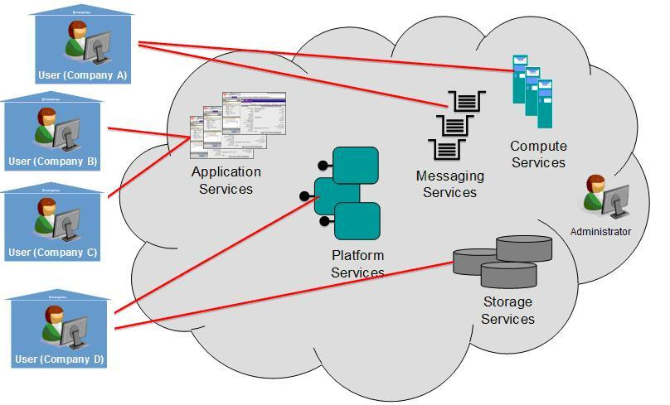
Public Cloud: https://www.researchgate.net/figure/Public-cloud-model_fig1_259369032

Slide 6
Characteristics of Public Cloud
Scalability
Cost effectiveness
Reliability
Flexibility
Location Independence
On demand computing
Pay per use pricing
broad network access
Resource pooling

Slide 7
Advantages of Public Cloud
It helps organizations to have less investment and maintenance costs
User demands can be easily met with scalability
less resource wastage
High reliability

Slide 8
Disadvantages of Public Cloud
As the cloud infrastructure is actually owned and controlled by others, the controls for the user are limited.
It is difficult to deploy regulations like HIPAA and PCI DSS in a public cloud and often demands a hybrid solution.
There may be data privacy issues
Limited control on the infrastructure configurations

Slide 9
Public Cloud Companies in market
Microsoft Azure ExpressRoute
Google Cloud Interconnect
AWS Direct Connect
Blue cloud by IBM
Alibaba Cloud
Oracle Cloud FastConnect

Slide 10
Private Cloud
The cloud infrastructure is provisioned for exclusive use by a single organization comprising multiple consumers (e.g., business units).
It may be owned, managed, and operated by the organization, a third party, or some combination of them, and it may exist on or off premises.

Slide 11
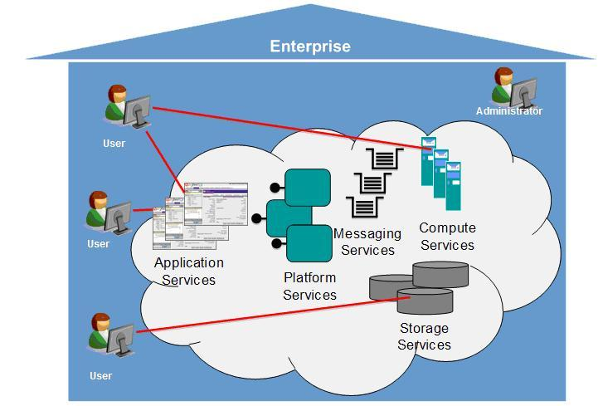
Private Cloud: https://www.researchgate.net/figure/Private-cloud-model_fig2_259369032

Slide 12
Characteristics of Private Cloud
One of the most conspicuous characteristics of a private cloud is driven by the need for security.
The private cloud is hosted on its own infrastructure with no other clients leasing this space, unlike the public cloud.
Another characteristic is that the private cloud is hosted on either owned or leased data centers, so the locations where your cloud is located is transparent to you.

Slide 13
Advantages of Private Cloud
Medium and large businesses typically chose a private cloud due to its protection, compliance, and scalability options. Other benefits include
Fine-grained control over your infrastructure.
Adapt better to the usage of resources as per demand.
If your business has to comply with bespoke industry standard compliance, the private cloud allows you to easily ensure your systems are totally compliant.
While you can scale to demand in a public cloud, the granularity of scale that the private cloud offers is of a significant benefit for some businesses.
Large to very large businesses might want to maintain a private cloud then use a public infrastructure especially with a competitor on it or the infrastructure itself owned by a competitor.

Slide 14
Disadvantages of Private Cloud
the associated cost. In general private clouds are more expensive than public
Operational efficiency in a private cloud is difficult to achieve. Underutilization is a major grouse in private clouds.
Scaling up on hardware and real estate space would be a challenge in private clouds.

Slide 15
Private Cloud Companies in market
Hewlett Packard Enterprise (HPE)
VMware
Dell EMC
Oracle
IBM
Red Hat

Slide 16
Community Cloud
According to NIST, the community cloud is the cloud infrastructure that is provisioned for exclusive use by a specific community of consumers from organizations that have shared concerns (e.g., mission, security requirements, policy, and compliance considerations).
It may be owned, managed, and operated by one or more of the organizations in the community, a third party, or some combination of them, and it may exist on or off premises

Slide 17
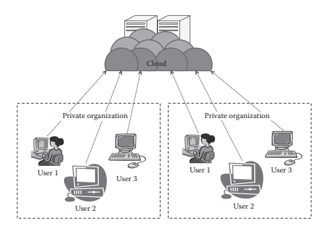
Community Cloud

Slide 18
Characteristics of Community Cloud
Collaborative and distributive maintenance: no single party has full control over the whole cloud
Partially secure: there is a possibility that the data can be leaked from one organization to another, though it is safe from the outside world
Cost effective

Slide 19
Advantages of Community Cloud
It allows establishing a low-cost private cloud.
It allows collaborative work on the cloud
It allows sharing of responsibilities among the organization.
It has better security than the public cloud

Slide 20
Disadvantages of Community Cloud
Autonomy of an organization is lost.
Security features are not as good as the private cloud.
It is not suitable if there is no collaboration

Slide 21
Community Cloud Companies in market
IBM SoftLayer

Slide 22
Hybrid Cloud
According to NIST, the hybrid cloud can be defined as the cloud infrastructure that is a composition of two or more distinct cloud infrastructures (private, community, or public) that remain unique entities but are bound together by standardized or proprietary technology that enables data and application portability

Slide 23
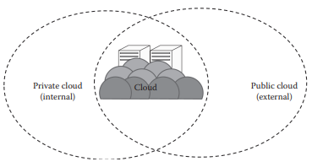
Hybrid Cloud

Slide 24
Characteristics of Hybrid Cloud
Scalable: The hybrid cloud is a combination of one or more deployment models
Partially secure
Stringent SLAs: As the hybrid cloud involved a public cloud intervention, the SLAs are stringent and might as per the public cloud service provider
Complex cloud management: Cloud management is complex and is a difficult task in the hybrid cloud as it involves more than one type of deployment models and also the numbers of users are high.

Slide 25
Advantages of Hybrid Cloud
It gives the power of both the private and public clouds.
It is highly scalable.
It provides better security than the public cloud

Slide 26
Disadvantages of Hybrid Cloud
The security features are not as good as the public cloud.
Managing a hybrid cloud is complex.
It has stringent SLAs

Slide 27
Hybrid Cloud Companies in market
Microsoft
IBM
PC Solutions….etc

Slide 28
Any Questions???

Slide 29
Thank You

